Slide 1

DASHBOARD REPORTING
USING ADVANCED EXCEL TECHNIQUES TO PROVIDE
DATA DRIVEN SOLUTIONS FOR REDUCING
TRAFFIC OFFENCES IN THE CITY OF DENVER

Slide 2

AGENDA
Executive Summary
Problem
Solution Approach
Key Findings
Recommendations
Key Findings
Offence By District
Offence By Neighbourhood
Offence By Time
Bicycle & Pedestrian Involvement
Recommendations
Appendix

Slide 3
EXECUTIVE SUMMARY
Recommendations
Data driven recommendations have been drafted for the following criterias:
Areas that need patrolling
Days of the week in need of more police
Districts with most offences
Months that require extra patrolling
Offence type that needs to be curbed on a priority basis
Key Findings
Solution Approach
Identify districts & neighbourhoods with most offences
Find out days, time of the day etc. reporting most offences
Identify the number of victims such as cyclists & pedestrians
Hot Spot Mapping of offences by victim, offence type.
Problem
Data Audit: Scan the data to review its completeness and accuracy
Data Cleaning: Fix the missing, redundant and unimportant information
Perform Analysis using EXCEL Tools like 3D Maps, Power Pivots, Slicers, Data Modeling & Transformation
Problem
Analysis: Find patterns in the traffic offences that occurred the City & County of Denver in 2012 to provide effective solutions
Techniques: How to find patterns in the data?
Visualization: Present key findings in a way easy to understand

Slide 4

KEY FINDINGS

Slide 5
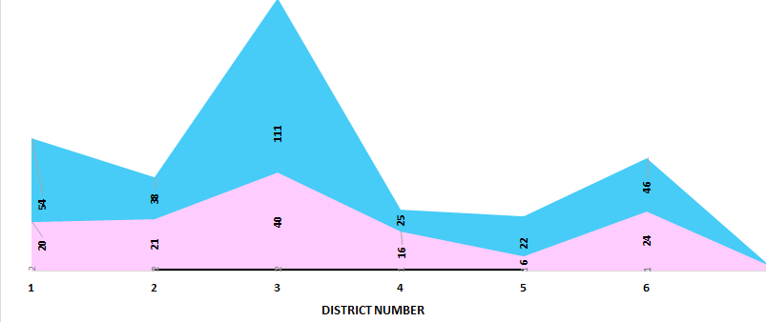


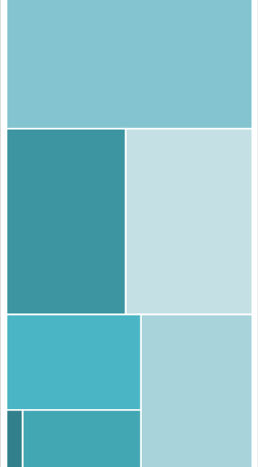

OFFENCE BY DISTRICT
Offence % in 7 Districts
Most Common Offence Type in 7 Districts
District 3
(35.1%)
Accident
Hit & Run
District 6
(16.4%)
District 1
(17.4%)
District 3, 1 and 6 respectively are top three in terms of offence rate
Accidents are considerably high in District 3 compared to other districts
District 3 also has the most number of neighbourhoods (25) which makes it susceptible to report more offences
District 4
(9.6%)
District 2
(14.1%)
District 5
(6.6%)
DISTRICT 7
Note: Data on population not available so results might be skewed

Slide 6
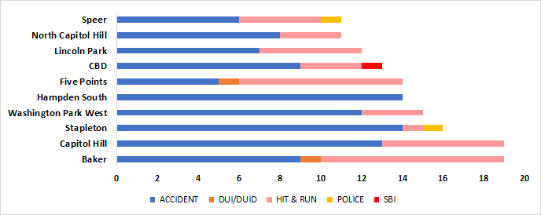
OFFENCE BY NEIGHBOURHOOD
Neighbourhoods with
number of Offences >10
Most Common type of offence in different neighbourhoods
Baker
Capitol Hill
Stapleton
Washington& Park West
Hampden South
Five Points
CBD
Lincoln park
At least 10 neighbourhoods with number of offences >10
Baker (D3) & Capitol Hill (D6) have highest number of offences (approx. 20)
Hampden South (D3) only has Accidents (approx.15)
Accidents & Hit and Run most common in these neighbourhoods
North Capitol Hill
Speer

Slide 7
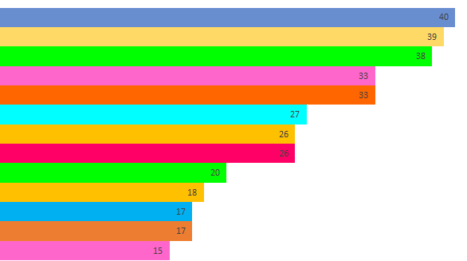
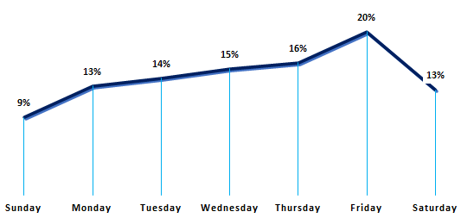
OFFENCE BY TIME
Number of Offences by Hour of the Day
Offence Percentage by Days of the Week
1:00 PM
4:00 PM
5:00 PM
6:00 PM
3:00 PM
12:00 PM
9:00 AM
8:00 AM
11:00 AM
2:00 PM
7:00 AM
6:00 AM
9:00 PM
Most Offences- 1:00PM
Least Offences- After 9:00 PM
Time Frame with most offences: 4-6PM
# of Offences b/w 4-6PM: 110
Most Offences: Friday (20%)
Least Offences: Sunday (9%)
Offences have seen a continuous increase From Sunday to Friday

Slide 8
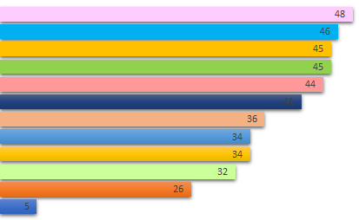
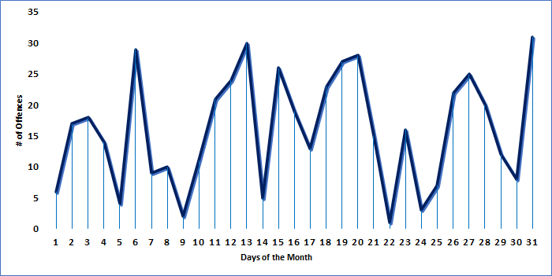
OFFENCE BY TIME (contd.)
Offences By Month
Offences By Days of the Month
April
September
May
January
December
June
August
March
February
October
November
July
Three months with most Offences:
April, September, May
Least Offences: July (5)
Peak Offence Days:
6th, 13th, 20th, 27th and 31st DoM
(Mostly Fridays in 2012)
Low Offence Days: (Mostly Mid Week)
5th, 9th,14th, 22nd, 24th and 30th DoM

Slide 9
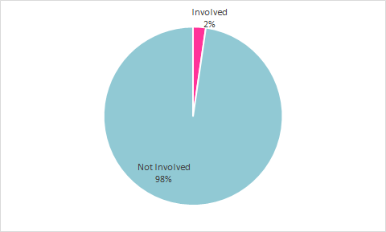
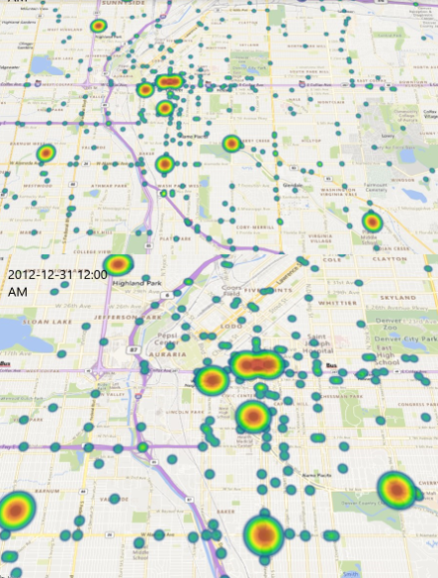
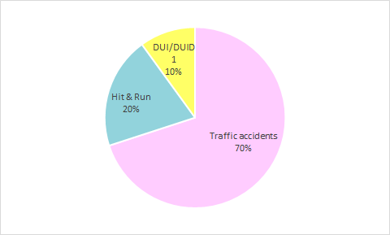
BICYCLE INVOLVEMENT
Percentage of bicycles involved
Offence Type involving Bicycles
Hot-Spots where Bicycles are involved
Bicycle involvement in overall offence- 2% (Low)
Type of offence in which bicycles are most involved: Traffic Accidents (70%)
Location where Bicycles are mostly involved:
North Capitol Hill, City Park West and CBD

Slide 10
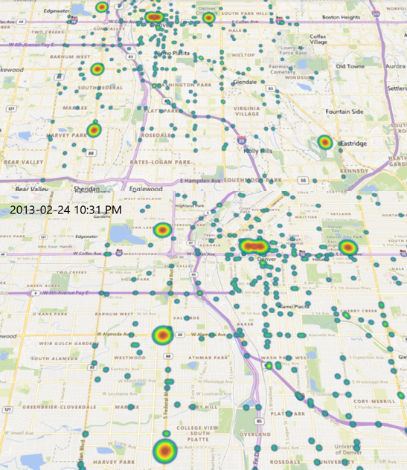
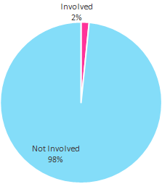
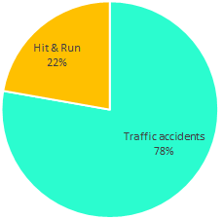
PEDESTRIAN INVOLVEMENT
Percentage of Pedestrians involved
Offence Types involving Pedestrians
Hot-Spots where Pedestrians are involved
Pedestrians involvement in overall offence- 2% (Low)
Type of offence in which pedestrians are mostly involved: Traffic Accidents (78%)
Location where pedestrians are mostly involved:
City park, CBD, College View - South Platte

Slide 11
RECOMMENDATIONS
Prioritize Offence Type to be controlled: Accidents and Hit Runs are major offence types so more emphasis to reduce them.
Target Districts: Districts 3 has most offences followed by Districts 1 and 6 respectively, so there should be stricter law enforcement in these districts.
Neighbourhood: Baker, Capitol Hill, Stapleton have reported most offences so authorities should be alert in these neighbourhoods.
Time of the Day: More traffic police should be deployed between 1:00PM to 6:00PM as most offences occur between these hours.
Day of the Week: Friday witnesses most offences so more patrolling on Fridays.

Slide 12
RECOMMENDATIONS
Month of the Year: April has most offences followed by September, May and January respectively so there needs to be more police during these months.
Days of the Month: Offences peak mostly on the 6th, 13th, 20th and 31st day of the month
(in the gap of 7 days). More traffic Police should be used on these days.
Bicycle Involvement: Bicycles are involved in 70% of traffic accidents. Locations such as North Capitol Hill, City Park West and CBD are hot spots. More surveillance and stricter enforcement in these areas.
Pedestrian Involvement: Pedestrians are involved in 78% of traffic accidents. City park, CBD, College View - South Platte are major hot spots. There needs to be stricter traffic law enforcement in these areas.

Slide 13
Thank You
Any Questions?

Slide 14
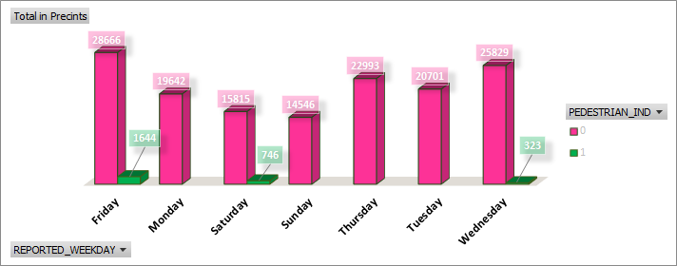
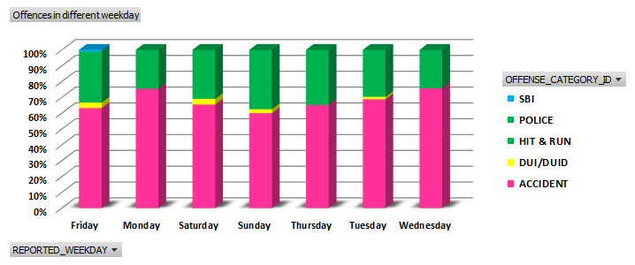
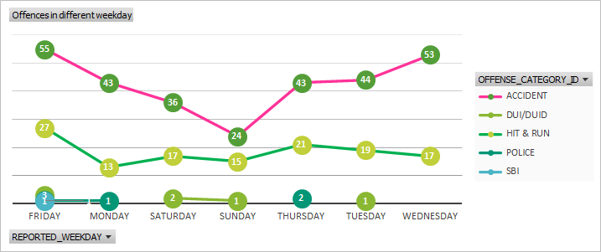
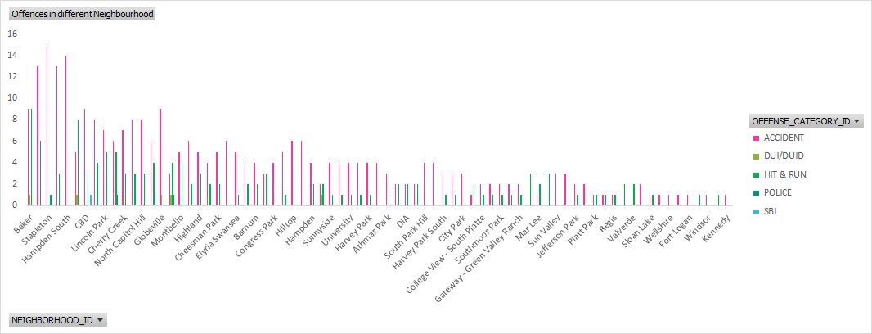
APPENDIX

Slide 15
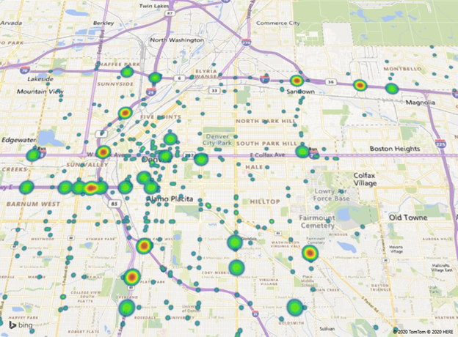
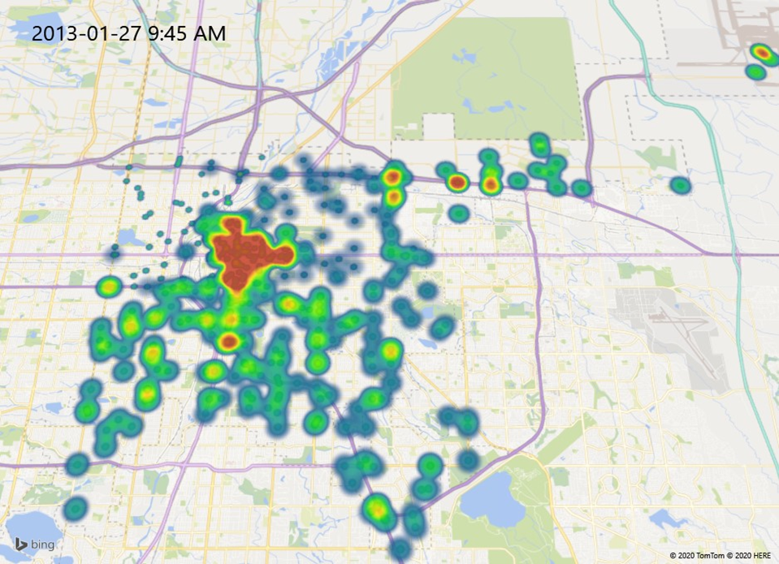
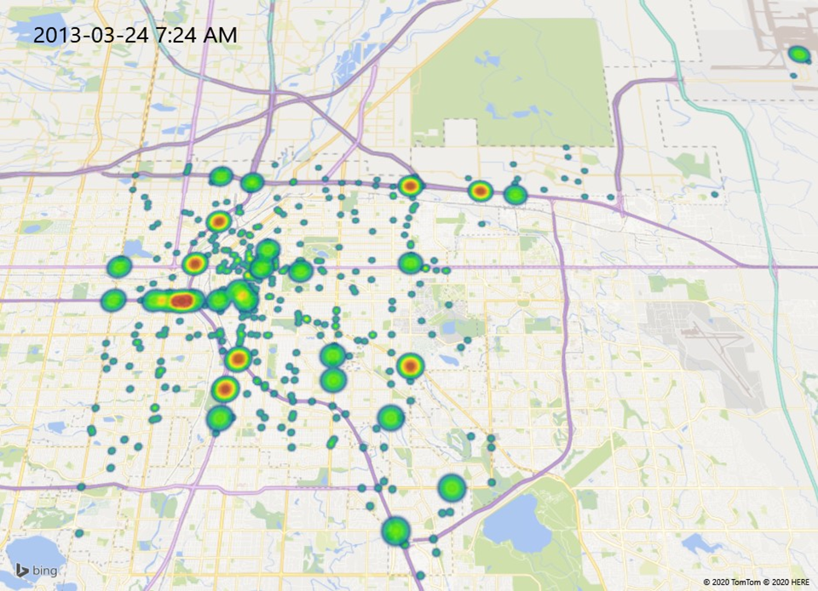
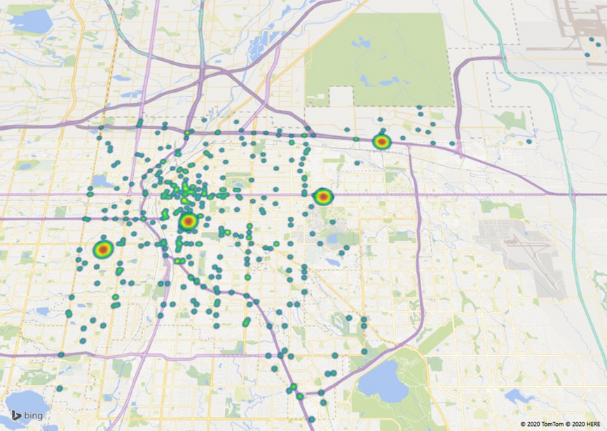
Areas where hit & run happen
Offence Hot-Spots in Districts
Offence Hot-Spots in Neighbourhood
Areas where Police Van involved

Slide 16
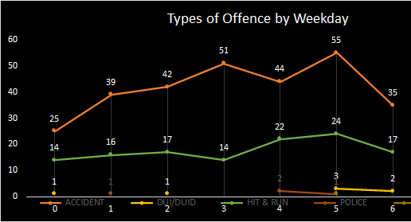
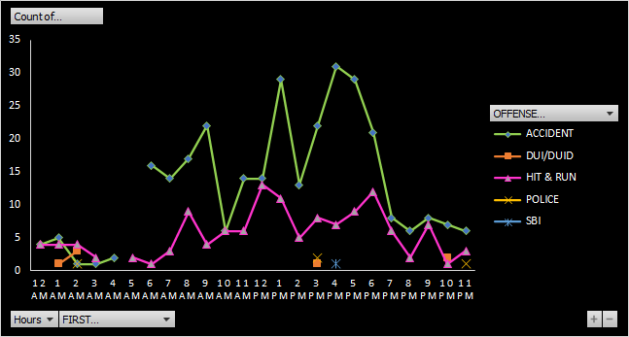
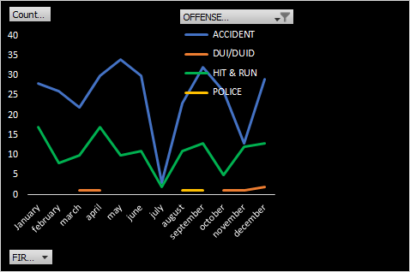
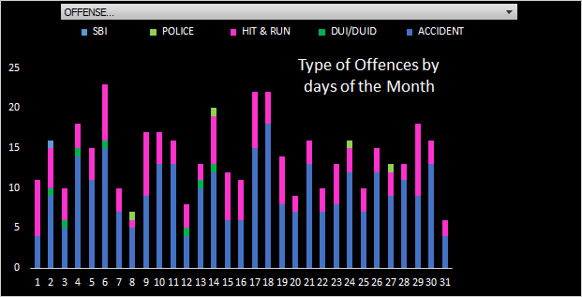
Offence Type By Hour of the Day
Offence Type By
Month of the Year

